Slide 1
Source Control
Duane Strong
Strong Engineering LLC
duanes@strongenging.com

Slide 2
What is it?
Manages what can easily become total chaos.
Part of a larger concern called Software Configuration Management
The task of tracking and controlling changes in the software. SCM practices include revision control and the establishment of baselines. If something goes wrong, SCM can determine what was changed and who changed it. If a configuration is working well, SCM can determine how to replicate it across many hosts.
Provides traceability from feature or change request to implementation.
Establishes tested baselines
Establishes a set of requirements for change acceptance

Slide 3
Why do we need it?
Any sufficiently large project becomes (mostly?) an exercise in containing complexity.
The nature of software development is such that it constantly tries to become just more complicated than humans can understand. Entropy is constant.

Slide 4
Why do we need it?
Team Co-ordination
Provides an authoritative source
Time Machine, can always get back to a prior version
Back up
Historian - Why did we do that?
Commit logs
Issue reference
Branches - Multiple Development Timelines
Allows feature development and bug fixes without disturbing the main time line

Slide 5
What do you put in it?
Anything
Not just software
This presentation
Maybe not huge things
Once you get used to the safety net you want it
Everything
Information radiator
Never have to ask someone for a document
Other tools might be better (wiki, ERP)
Not generated items
Not 3rd party SDKs, etc.

Slide 6
A Little History
SCCS (1972) RCS (1982)
Like a library book
Where the term 'checkout' comes from.
Files locked by one person at a time
Hard to collaborate, usually not working on the same part of a file
Promotes cheating

Slide 7
A Little History
CVS (1986) Multiple concurrent checkouts
No locking
Must ‘update’ prior to commit
Diffing, merging. Context aware diff
What is a conflict?
SVN (2000) Improved CVS
Atomic commits
Change sets have versions not files
Database
Improved network transports

Slide 8
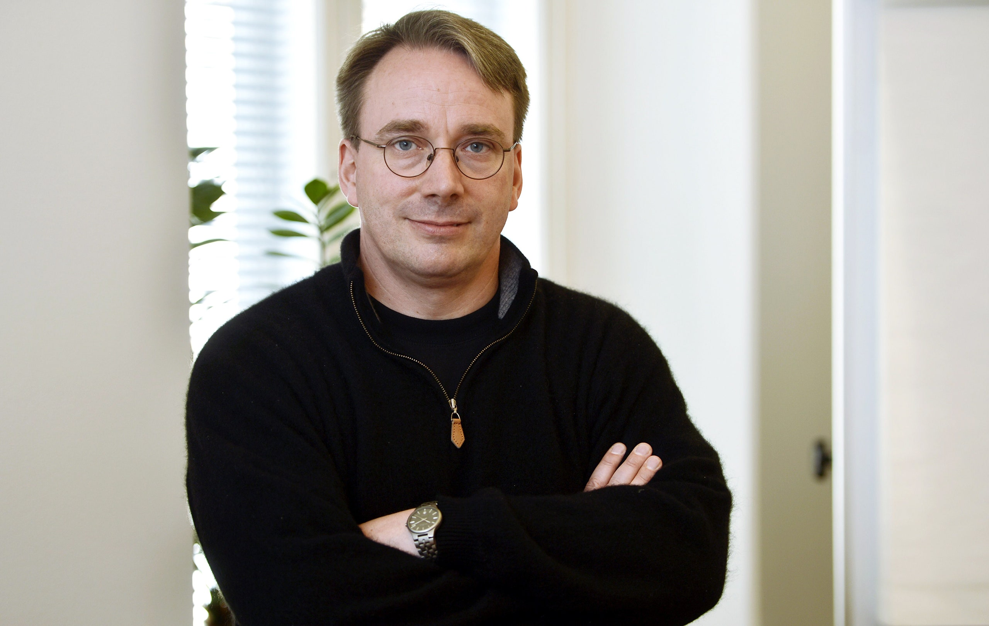
A Little History
Git (2005) Linus Torvalds
Distributed – everyone has an entire repository copy
No diffs, whole versions (storage is cheap)
Open source projects have special requirements
Distributed teams
Replicated repository, push/pull

Slide 9
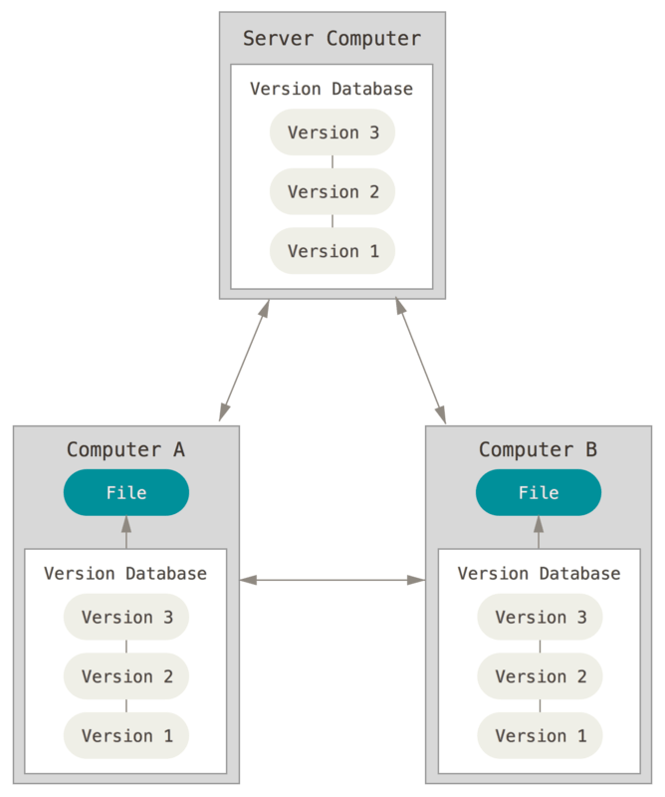
Git – how does it work?
Clone local copy of the repo (.git)
Central server not required
Not delta based
Every change is an entire new copy

Slide 10
Git – how does it work?
Blobs and the magic of SHA
160 bits long about 10⁴⁸
A trillion people generating a trillion new blobs
per second for a trillion years is only 10⁴³
Associative memory
What is a blob?
Files
Trees
Commits
Tags
Instantaneous branching

Slide 11
Git - terminology
Cloning
Origins
Remote tracking branches
Master branch
Feature/Issue branch
Working directory

Slide 12
Git Terminology
Staging
Commit
Push
Pull (Fetch + Update)
Refs
HEAD
Tags
Remotes

Slide 13
Git
Staging changes
git add (new and modified)
git rm
git mv (not really necessary)
Commit
Atomic
git commit
Enter meaningful commit messages. Not "updated' or "fixed".
Push
git push

Slide 14
Git
git status
.gitignore
Cascades
Branching
git branch
git checkout
Checkout changes files in your working directory – tries to not let you mess up

Slide 15
Git
Stashes
Merging
git merge
Conflicts
<<<<<<< HEAD:index.html
<div id = footer> contact : email.support@github.com</div>
=======
<div id = footer>
please contact us at email.support@github.com</div>
</div>
>>>>>>> mybranch:index.html

Slide 16
Git Frontends
Command line 'porcelain’
I almost never use
Visual Studio
Eclipse eGit
SourceTree
Tortoise
Github / Gitlab web interfaces

Slide 17
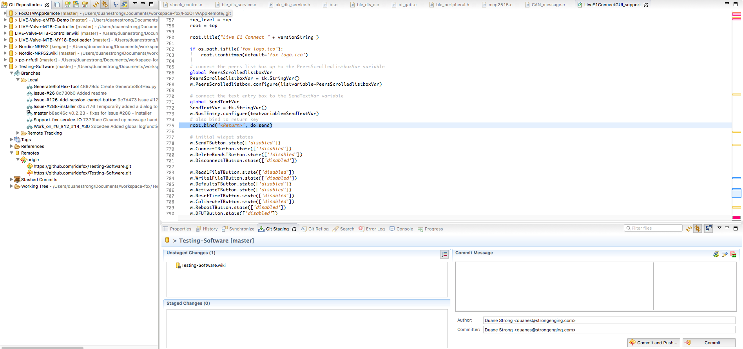

Slide 18
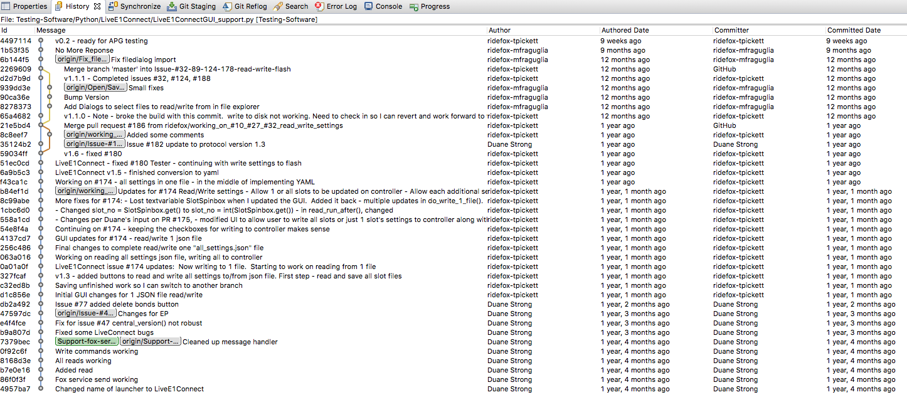

Slide 19
Workflows
Never commit directly to master branch.
Create branch for an issue
All work reviewed by at least one other pair of eyes
Bugs are exponentially more expensive to fix the farther down the process they live
Keeps at least one other team member in the loop
All work should be traceable back to an issue.
Merge to master branch
Use tools to enforce an acceptance criteria

Slide 20
Don’t be one of those people
Learn your tools well and know what they can do for you.
Enter meaningful commit messages. Not "updated' or "fixed".
Don’t commit junk files (.o .bin)
Use .gitignores to filter out files/directories that should not be checked in
.gitignore is applied cascading down the directory hierarchy. It is considered rude to filter out generic names at the root folder.
Don’t commit settings that are particular to your workstation (install paths etc.).

Slide 21
Don’t be one of those people
Have healthy respect (fear?) when pushing. You are affecting others lives.
Don't just add all to git staging. Carefully pick the files to stage. Diff them to head to make sure you didn't leave something in you did not mean to.
If you break the build you will be in the dog house. Most projects have multiple dependencies.

Slide 22
Mono repo vs. multi repos
How much do I put into one repo?
Cross project commits / code sharing / code access
Atomic commits
Submodules
Another repo as a subdir
Tracks at what commit that repo should be
Not really connected to each other
Subtrees
Another repo as a subdir
Requires user to not mix commits
Requires multiple steps for merge
Side by side repos – not a repo

Slide 23
Q & A

