Slide 1
Github
Duane Strong
Strong Engineering LLC
duanes@strongenging.com

Slide 2
What is it?
Centralized git server
User accounts
Authorizations
Repos granted access
Web git interface
Pull Requests / merge Requests
Issue tracking
Project Kanban board
Wiki
Releases
Notifications
CI/CD
Others – Gitlab, Atlasian Stash / Bitbucket / JIRA / Confluence

Slide 3
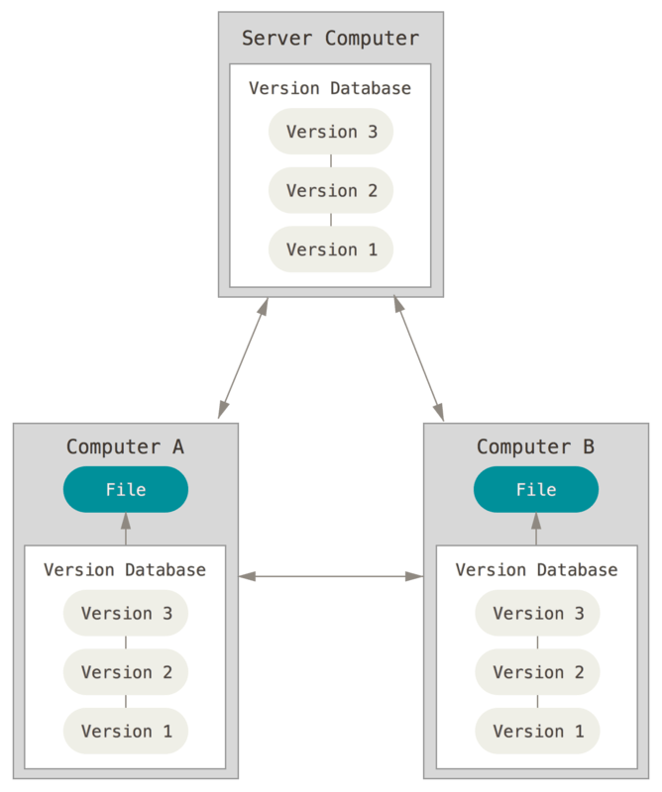
Git – how does it work?
Clone local copy of the repo (.git)
Central server not required
Not delta based
Every change is an entire new copy

Slide 4
Centralized git repos
Backed up
Secure = TFA, SSH, OAuth, Personal access tokens
Public vs. private
Organizations

Slide 5
Web git interface

Slide 6
Web git interface UPDATE 6/21/20

Slide 7
Issue Tracking
What is an Issue?
New features
Bugs
Resources
What is in an issue?
Description / Notes
Labels
Assignees
Notifications
Links to projects / milestone

Slide 8
Issue Tracking

Slide 9
Markdown
Text formatting
# headings
* lists
1. numbered lists
**bold** *italic*
Links
[text](url)
People
‘at’ name
Readme.md

Slide 10
Issues
Attachments
Drag & drop
Cross References
#323 -> Issue or PR 323
popup text
Link - backlinks
Permanent thread record
Not email

Slide 11
Projects
Organizes Issues
Kanban board
Columns / Labels
Automation
Note vs. Issue
Kanban flows
An issue can appear in multiple Projects

Slide 12
Projects

Slide 13
Project Column Automation
Preset | Options
To Do | Move all newly added issues here Move all newly added pull requests here Move all reopened issues here Move all reopened pull requests here
In Progress | Move all newly opened pull requests here Move all reopened issues here Move all reopened pull requests here Move all pull requests that meet the base branch's minimum number of required reviews here Move all pull requests that no longer meet the base branch's minimum number of required reviews here
Done | Move all closed issues here Move all merged pull requests here Move all closed, unmerged pull requests here

Slide 14
Milestones
Organizes issues
Seem like Projects but not really
Projects are visual
Milestones have time boxes
An issue can only be in one milestone

Slide 15
Milestones

Slide 16
Wiki
A little history
Ward Cunningham wiki wiki web 1995
Other wiki sites, Wikipedia, mediawiki, twiki
It’s a repo too, keeps all history
Markdown
Sidebar, footer
Differences between git repo and wiki
No branches
Navigation

Slide 17
Wiki

Slide 18
Wiki
Since it is a repo
You can edit offline
You can add attachment files
Team should never have to hunt for documentation
Might be better to just put markdown docs with the codee it goes with
GitHub renders it in the web view
Easier to find and edit than being in the wiki
Perhaps that should be your readme.md?

Slide 19
Releases
Tags
Automatically archives a source zip and tar
Attach large binaries

Slide 20
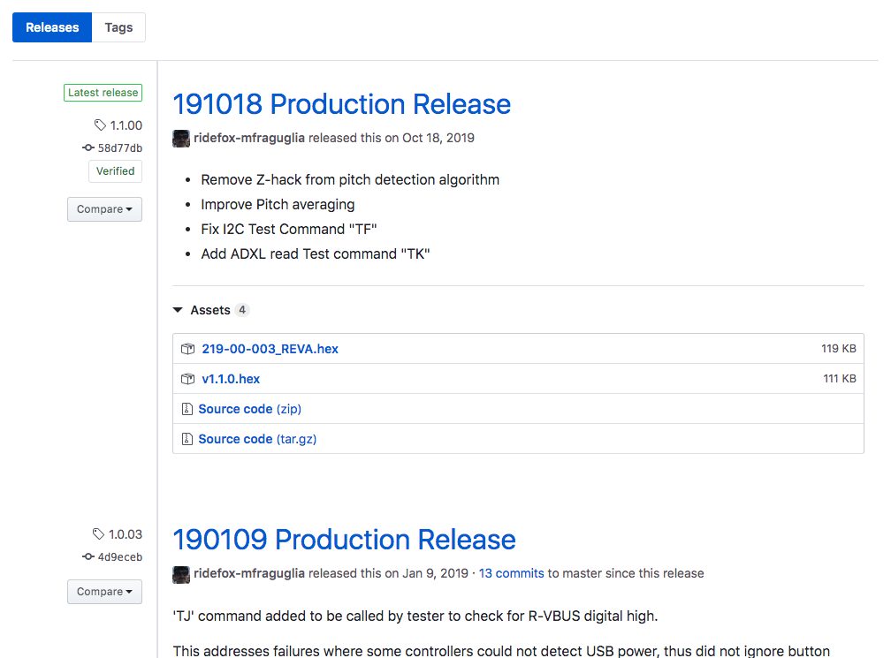
Releases

Slide 21
Notifications
Markdown ats @
Assigned to
PRs
Merges

Slide 22
Pull Requests (Merge Request)
A type of issue
Notes - Markdown
Attachments
Notifications
In browser code reviews
Reviewers
Side by side compare / diff
Annotations
Approval / rejection

Slide 23
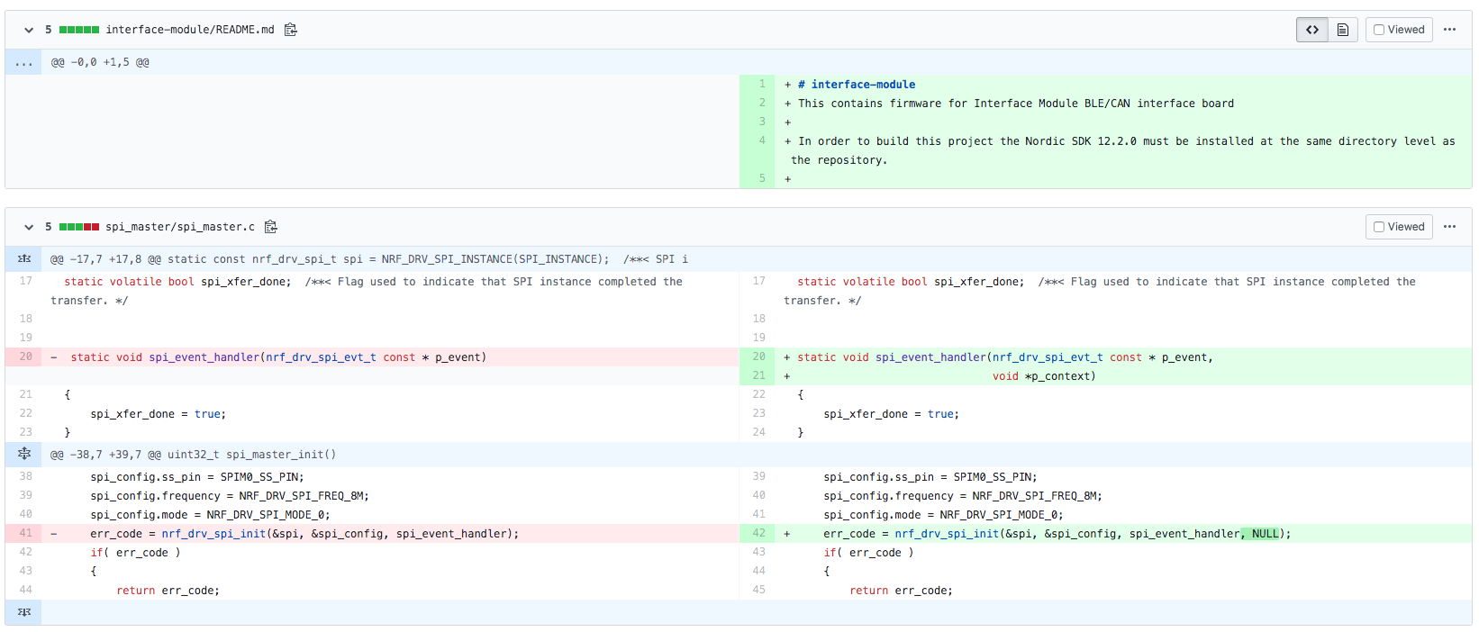
Pull Requests

Slide 24
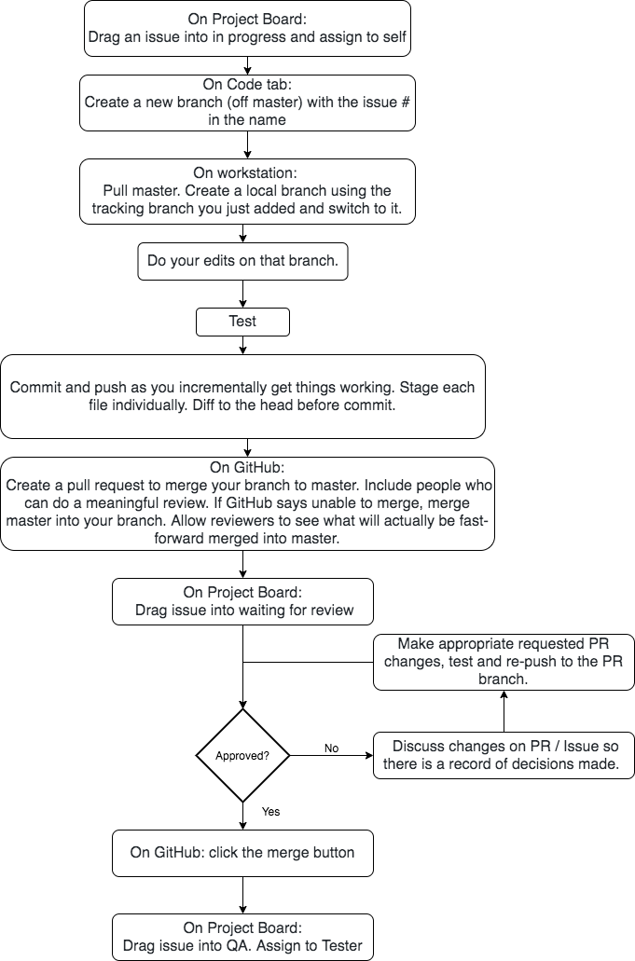

Slide 25
Forks
A GitHub thing not a git thing
Used when the intent is to totally or partially ‘disconnect’ from the original repo
Like a clone, but creates a totally new GitHub repo in your account
Collaboration is still possible via pull requests
Users don’t need write access to your repo to collaborate
Full development history of the fork is not put into original
Merge is done on behalf of someone else

