Slide 1
Agile Development using Scrum
Duane Strong
Strong Engineering LLC
duanes@strongenging.com

Slide 2
We had a problem in 1968
NATO conference of 1968 'Software Crisis’
Massive bugs
Late
Failure to deliver working software
Unhappy stake holders
Most features unused
Obsolete on arrival
Only going to get much, much worse

Slide 3
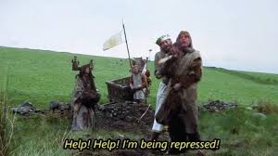
Roots of the problem
Agrarian to industrial revolutions
Similar models, social stratifications
Workers largely unskilled and uneducated
Creativity belongs to those who control the means of production
Little respect for those doing the work

Slide 4
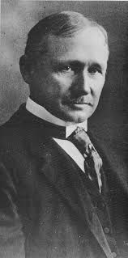
Frederic Taylor 'Taylorism’
Managers think, workers do
Managers closely supervise workers
Standardized tasks
Quality control by batch inspection and rejection, carrot and stick
Up front planning, specification
Large 'ceremony' moving from stage to stage, waterfall model
But it did massively increase production

Slide 5
Industrial paradigm fails for software development
Increasing up front planning, scheduling, design made no improvement
Value creation vs. value extraction
Complex emergent specification and design
Impossible to plan entirely before hand
Impossible to specify completely up front
Rapid change
Workers know more than the managers, highly educated and skilled
“Decision latency”

Slide 6
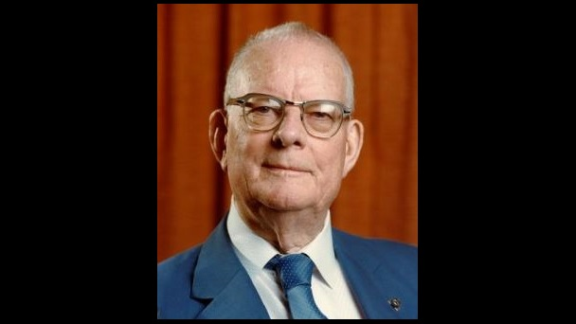
Roots of the solution
William Edwards Deming, Japan WWII reconstruction
Plan Do Check Act
Kaizen
The Toyota Way
lean manufacturing
Kanban

Slide 7
A new paradigm shift - agile
It's not a progression, it's a revolution
It can't be phased in
Fundamental thinking, behavior of people and organizations has to change
Many fail to adapt, organizations and individuals
Results can not be measured in the same ways
Cargo cults
Superficial – Mechanical – Competent – Enlightened

Slide 8
'Agile manifesto' 2001
Value individuals and interactions over processes and tools
Value working software over comprehensive documentation
Value customer collaboration over contract negotiation
Value responding to change over following a plan
It is NOT that the thing on the right has NO value, we just value the thing on left more

Slide 9
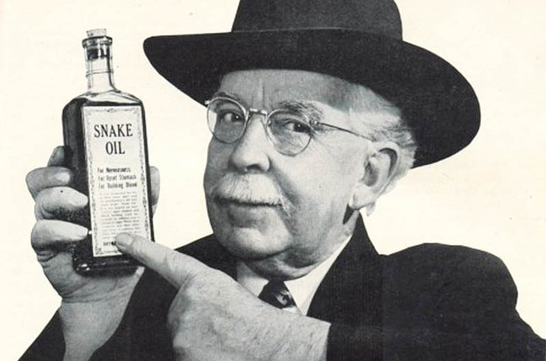
Early snake oil
Ironically heavy in prescription. "Follow these steps and silver bullet"
Badly integrated into existing power structures
Seen as latest fad
More money more problems
False starts, but now converged
Still, “licensed scrum master”

Slide 10
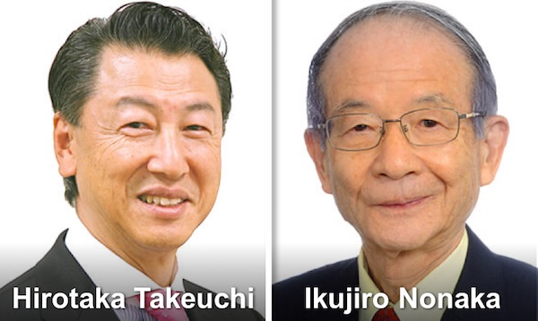
Enter SCRUM
Hirotaka Takeuchi and Ikujiro Nonaka 1986 paper "The New New Product Development Game"
Jeff Sutherland and Ken Schwaber 1995 conference presentation
A framework not a methodology, it has to be applied as each organization sees fit
A simple few page description, but like chess easy to learn hard to master
Requires discipline to respect the rules of the game, the players, accountability

Slide 11
The Fundamentals
Embrace change
Self organize
Business value focus
Continuous improvement
Non interruption
Customer centric
Radical transparency

Slide 12
The Values
Commitment
To team
To quality
To learn and improve
Focus
Openness
Respect
Courage

Slide 13
The Players
Small team
No one player is 'in charge' of the others. Each must collaborate with the others
Self organizing
The Product Owner
The Development Team
The Scrum Master
But they COLABORATE! No hierarchy. No silos. No us vs. them. One team.

Slide 14
The Product Owner
Is a one person role that injects the business perspective into the process
Represents other stakeholders to the rest of the team
Maintains an overall product vision and roadmap
Maintains the product backlog (issues) continually and in order
Decides release dates and content

Slide 15
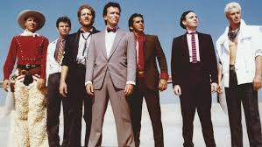
The Development Team
Self organizes – how much and how to do it
Develops code, tests, PCB, mechanicals, etc. – cross functional
Estimates the backlog efforts
Sets the amount of backlog items to do per sprint

Slide 16
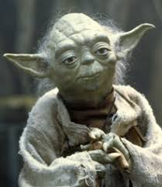
The Scrum Master
Is a one person role that facilitates the collaborations between the product owner and development team members.
Master of no one, master of scrum skills
Coaches and mentors the players in the game of Scrum
Shields the team from interference
Removes obstacles or impediments
Provides retrospectives
Guides continuous improvement

Slide 17
Sprints
Badly named. A rugby thing? Continuous never ending cycles of work kept at a maintainable “all day” pace. It’s a value attempt.
Consistent time boxed iterations of backlog items
Delivers a working version of software each time
Best effort to complete, non interruptible but cancellable
Comprised of
The sprint itself
sprint planning
daily scrum meetings
sprint review
sprint retrospective

Slide 18
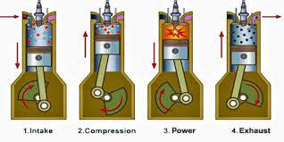
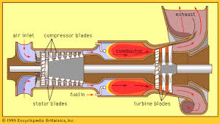
Why Sprints?
You don’t have to have sprints to be agile but…
Scrum vs. Kanban, piston engine vs. turbine engine
Chaos of change vs. sticking to a plan
Continuous delivery
Allows reflection and correction
Provides a sense of velocity

Slide 19
Sprint Planning
Relies on backlog refinement to make it less onerous
Before the sprint starts, all team members
Get backlog items into a sprint backlog
Get sufficient definition on items
Get sufficient estimations
Get items in priority
Decide what can get done in the sprint

Slide 20
Daily Scrum Meeting
SHORT 15 minutes. Stand up. Every day. Maybe
Three questions
What did you do?
What are you doing?
Any impediments?
Walk the board
Issues from right to left
But make it whatever works for you

Slide 21
Sprint Review
Share what is DONE – demos, videos, papers
Get feedback on what the team has done from outside the team
Get closure on the sprint, celebrate accomplishments
Determine actual team ‘velocity’, how much a sprint can hold

Slide 22
Sprint Retrospective
The continuous improvement part
Scrum Master runs it
Does it have to be at the end of every sprint?
Free food works great
How has team worked together?
What did you like?
What was lacking?
What failed?
What did you learn?
What do you long for going forward?

Slide 23
The Artifacts
Product backlog
Sprint backlog
Sprint deliverable

Slide 24
Part 2
“From the trenches” or “What I wish someone told me when I started”
Overall – don’t be pedantic. There is no existing recipe. Take whatever people tell you (even me) in and find your own path.
However, don’t ignore well trodden paths. They are usually well trodden for a reason.

Slide 25
Backlog Refinement
Continuous not time boxed
Issues as ‘user stories’
As a <role> I want <feature> so I can <rationale>
Issues as behaviors
Given <context> when <event> then <result>
Issues as bugs
Anyone can put anything into the backlog. I will get triaged by the product owner
Error on the side of putting things in the backlog vs. dropping the ball
Ok if not fully fleshed out
Break down large stories into issues that can be sprint-ified

Slide 26
Visualizing Progress
Transparency - information radiators
Burn down or others
Kanban (Project) board
No status reports!

Slide 27
Velocity
How many story points on average can the team do in a sprint?
What’s a story point?
Is it hours?
Is it days?
Is it arbitrary?
Non linear due to cone of uncertainty
People are bad at absolute estimates, but good at relative ones

Slide 28
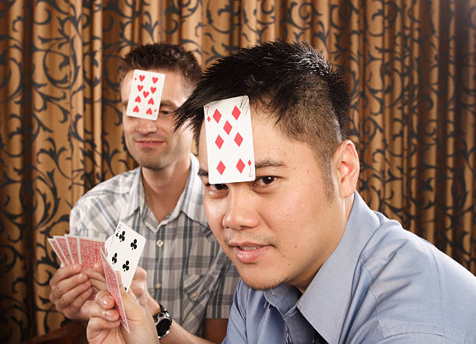
Planning Poker
I have an idea how hard this story is.
You have an idea how hard this story is.
Without influencing each other
ahead of time, put your cards on the
table.
If we don’t have the same estimate,
one of us knows something the other
does not. Figure that out.

Slide 29
Failure
Failure is part of emergent design. Failure on an attempt to add value without recovering some knowledge about that failure is waste.
We don’t strive to fail but…
We should accept it as part of the value creation exercise
Make failures quick to discover
Keep failure cheap
Figure out how to extract knowledge from failure
This is the purpose of the sprint retrospective

Slide 30
Kanban/Scrumban
Scrum is not the only way to be agile. Many teams have decided that Scrum requires too much overhead.
Kanban focuses on flow of issues rather than fixed sprints
#NoEstimates – size issues to be the unit of work, estimate by count of issues.
May be a better fit with Continuous Integration and Continuous Deployment
Can be applied to “what you do now” as opposed to a sea change

